Slide 1

Analysis of U.S. Online Sales Performance
BY AJANAH-IBRAHIM SALIM
OCTOBER 2024

Slide 2

Introduction
This report analyzes the KPIs of online stores in the United States to uncover trends and identify growth opportunities. By examining sales data, profit margins, and customer behaviors, I aim to provide actionable insights that will enhance business performance.

Slide 3

Aim and Objective
Objective: To analyze the online sales data to identify trends and patterns affecting revenue growth.
Key Questions:
What are the total sales figures and profit margins?
How efficient is the delivery process?
What insights can be drawn from sales performance across various categories?

Slide 4



Methodology
45%
Kaggle
Data was collected from Kaggle and analysis was done through Power BI tools, including dashboards and visualizations.
Power Bi

Slide 5
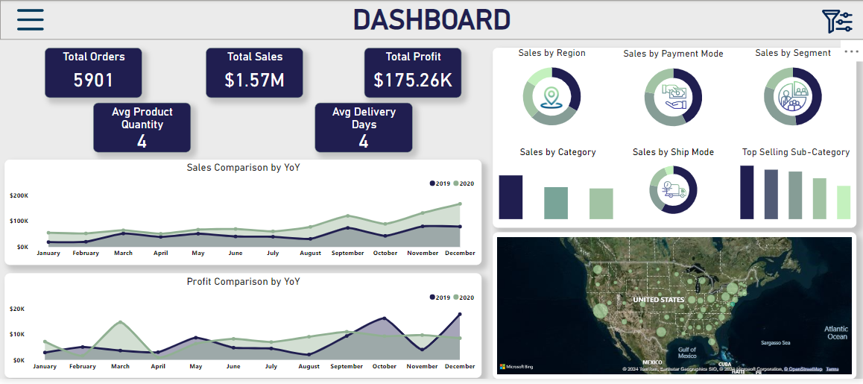
Dashboard Overview

Slide 6
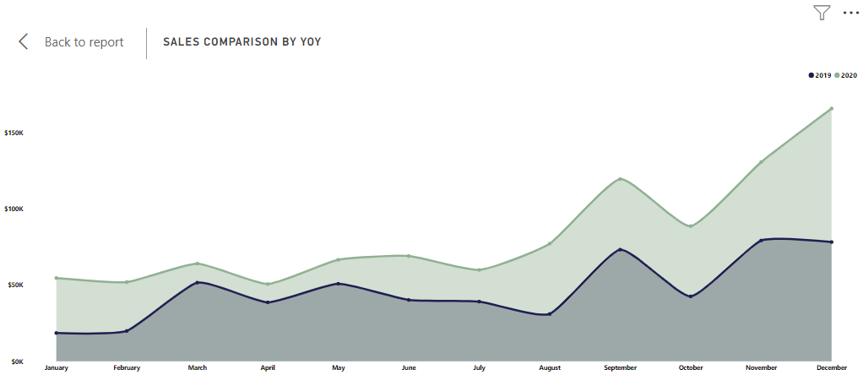
Sales and Profit Year-Over-Year (YoY) Comparison
Sales Comparison by YoY

Slide 7
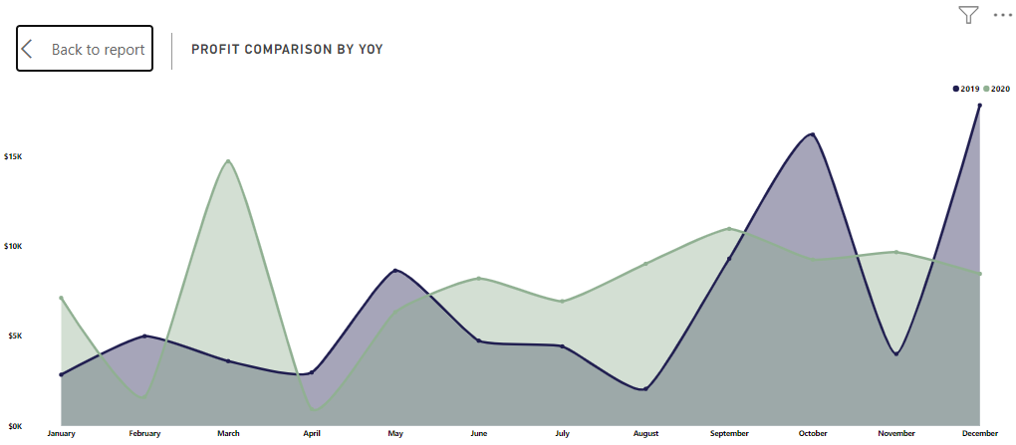
Sales and Profit Year-Over-Year (YoY) Comparison
Profit Comparison by YoY

Slide 8
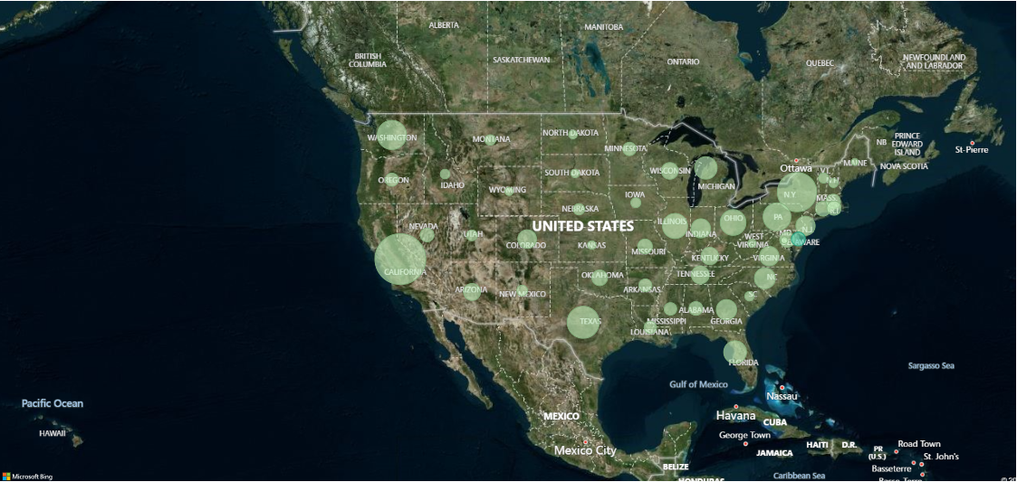
Sales by Region

Slide 9
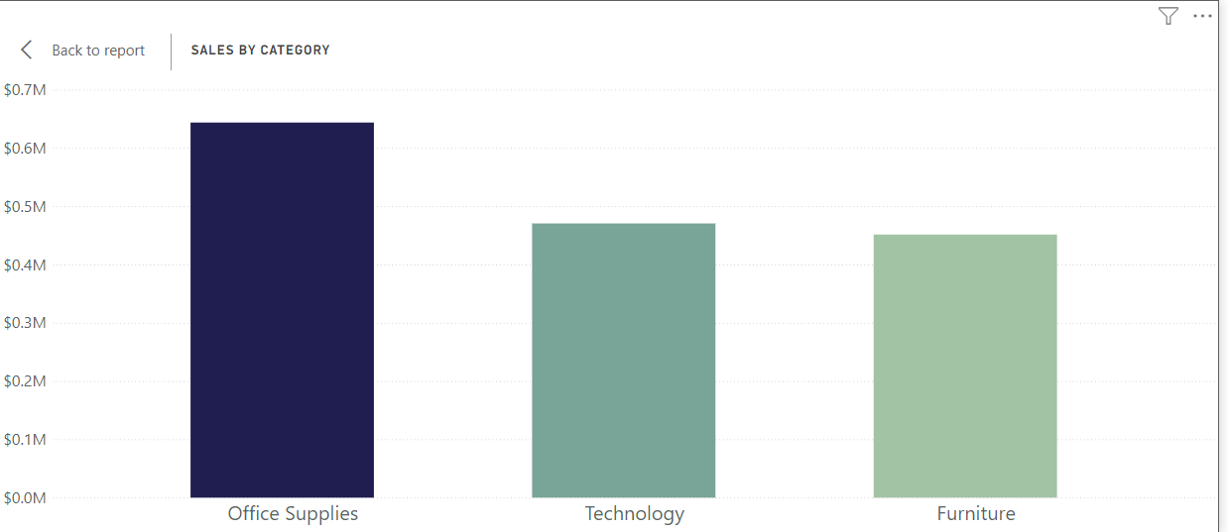
Sales by Category and Sub-Category
Category

Slide 10
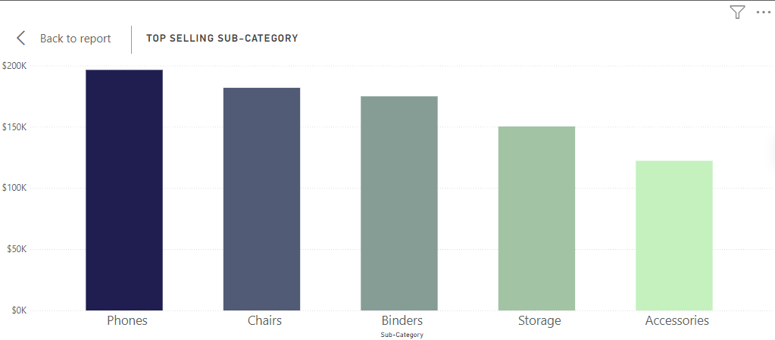
Sales by Category and Sub-Category
Sub-Category

Slide 11
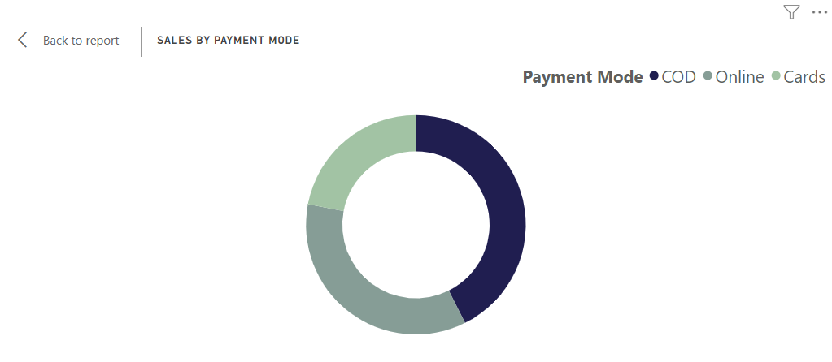
Payment Mode and Shipping Method Preferences
Payment Preferences

Slide 12
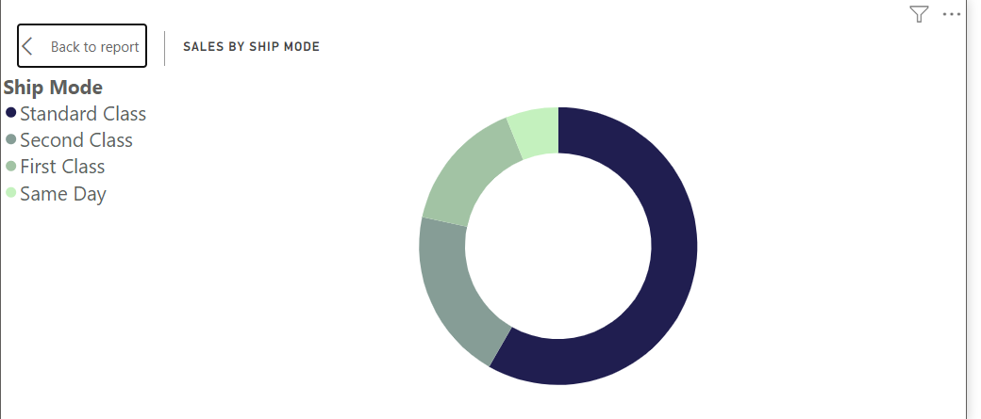
Payment Mode and Shipping Method Preferences
Shipping Method Preferences

Slide 13

Results
Total Sales: Increased from $564.68K in 2019 to $1.00M in 2020 (77% growth).
Total Profit: Fluctuated, with notable declines in April due to lower sales in technology.
Sales by Category:
Office Supplies: Grew significantly to $468.76K in 2020.
Top-Selling Sub-category: Binders in 2020; Tables saw a decline.
Monthly Insights:
California led sales; Washington showed significant growth.
Decline in October profits observed in both years.

Slide 14

Conclusion
The analysis of the U.S. online sales data reveals significant growth trends, particularly in total sales and specific categories like Office Supplies. While total sales rose dramatically, profit margins showed volatility, highlighting the need for ongoing monitoring of market conditions. The findings suggest that targeted strategies in high-performing regions and categories could further enhance revenue. Understanding these dynamics is crucial as we adapt to an evolving retail landscape.

Slide 15
References
https://www.kaggle.com/datasets/monisamir/online-super-store-sales
This is the link to my dataset

Slide 16

Thank you
Any question please

